Slide 1
ELEC 3310
Lecture 09
Finite State Machines
Registers
Digital Fundamentals & System Design
Instructor: Levent Yobas

Slide 2
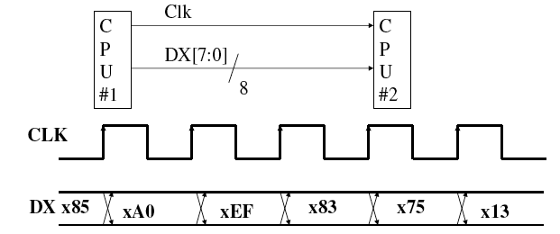
Application – parallel data transfer
  Multiple number of bits are transferred from one place to another (e.g. from one processor to the other processor)
  Use parallel registers in the source and destination
  Requires a lot of lines between the sources and destination, that may be expensive especially if the distance is long and the speed of transfer is high

Slide 3
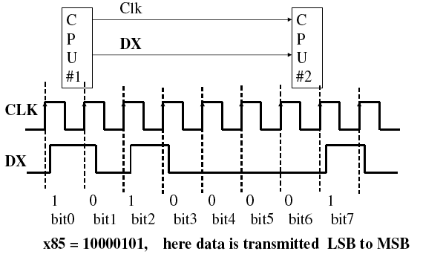
Application – serial data transfer
To reduce the number of parallel wires, we can transfer data in serial fashion, i.e. one bit at a time.

Slide 4
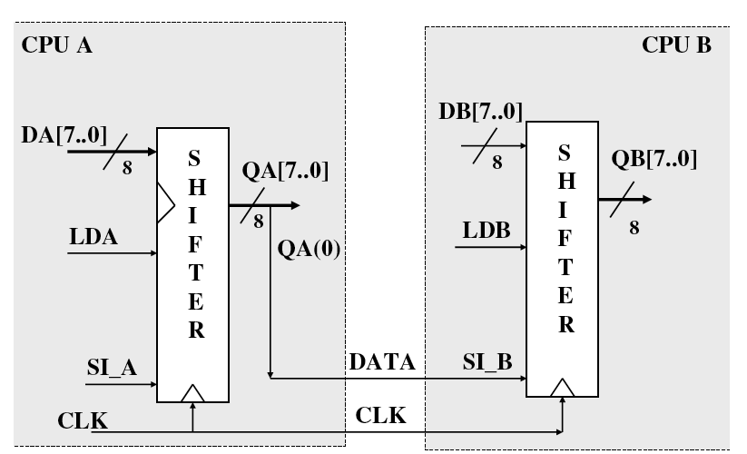
Application – serial data transfer

Slide 5
Application – serial data transfer
x00
x80
x40
xA0
x50
x28
x14
x0A
x00
x85
x85
x42
x21
x10
x08
x04
x02
x01
10000101
00000000
00000000
10000000
01000000
10100000
01010000
00101000
00010100
00001010
00000000
10000101
10000101
01000010
00100001
00010000
00001000
00000100
00000010
00000001
00000000
0
0
1
0
1
0
1
0
0
0
0
1
0
0
1
2
3
4
5
6
7
8
9

Slide 6
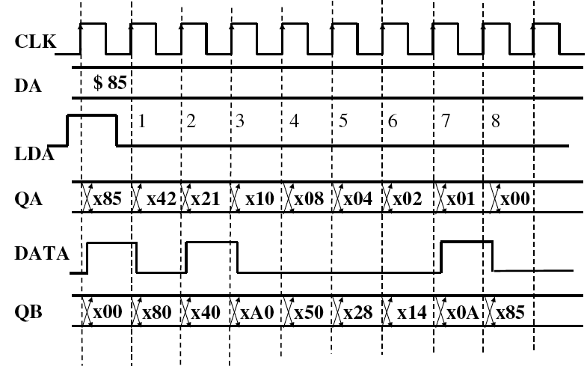
Application – serial data transfer
SI_A = 0; QA, QB initially at x00

Slide 7
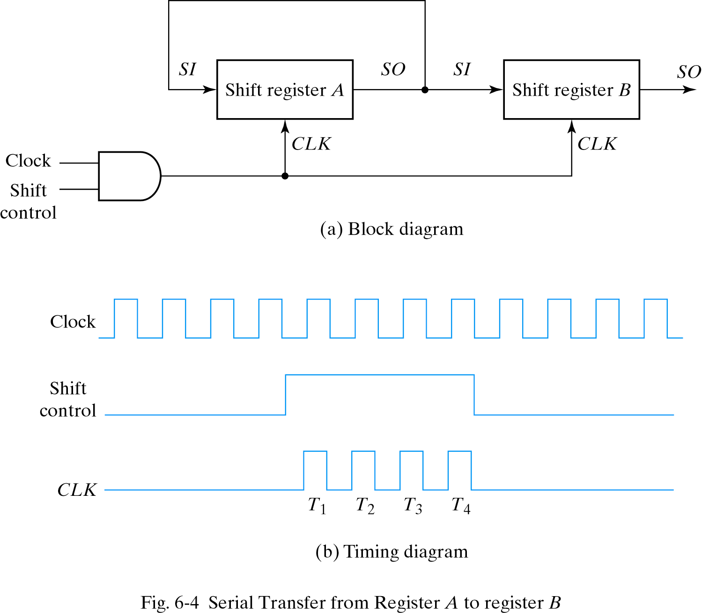
Application – serial data transfer
A system is in serial mode when information is transferred one bit at a time
E.g. we need to transfer a 4-bit data stored in a 4-bit register A to another 4-bit register B
Use shift register to do serial transfer (i.e. transfer 1 bit at a time)
In general, it takes n clock cycles to serially send n bits form source to destination
Timing pulse shift reg. A shift reg. B
Initial value 1 0 1 1 0 0 1 0
After T₁ 1 1 0 1 1 0 0 1
After T₂ 1 1 1 0 1 1 0 0
After T₃ 0 1 1 1 0 1 1 0
After T₄ 1 0 1 1 1 0 1 1
Data in A gets loaded into B after 4 clock cycles

Slide 8
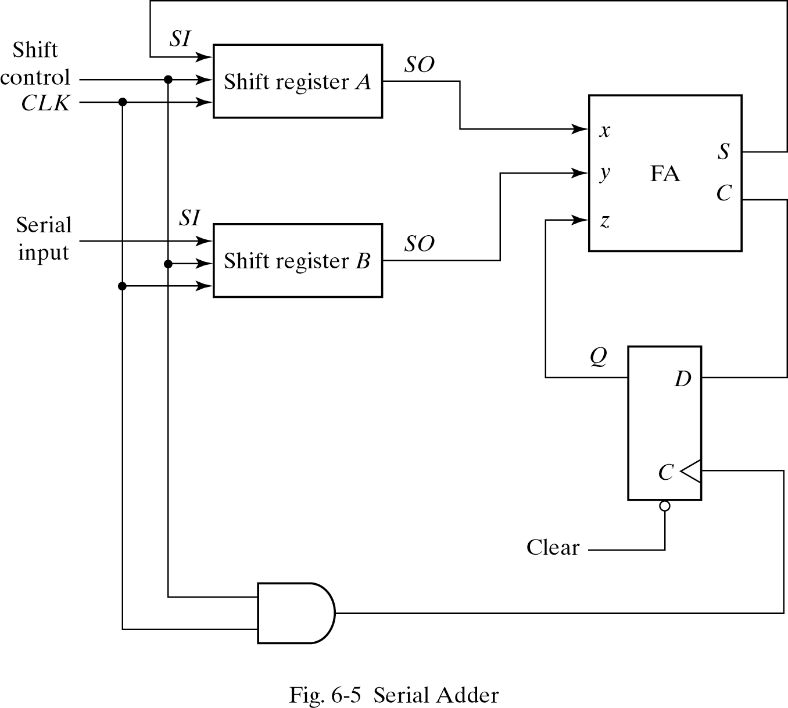
Application – serial adder
Another usage for shift register is for serial computation.
Normally we do computation in parallel, i.e. for n-bit addition, we do all the bit adding at the same time.
Serial adder: use a 1-bit adder to do n-bit addition in multiple clock cycles
Shift register A: the augend
Shift register B: the addend
Both the augend and addend are shifted to FA for addition
The carry-input is through the DFF by a delay of one clock cycle

Slide 9
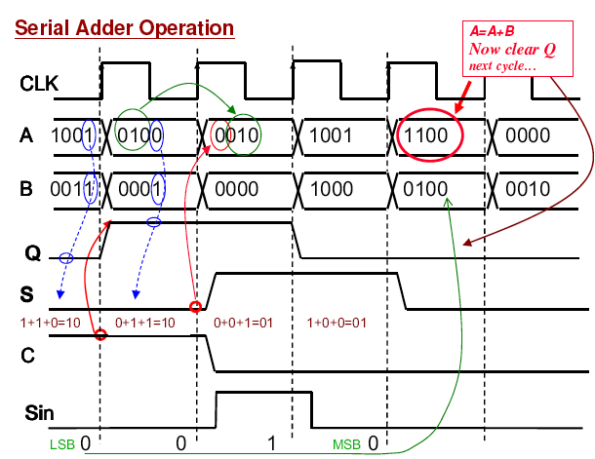
Application – serial adder
0
0
1
1
1
0
1
0
0
1
1001
0
0100
0010
1001
1100
1
2
3
4
1
1
0
0
0
0011
0001
0000
1000
0100
1
1
0
0
0
0
0
1
0
0
1
1
0
0

Slide 10
Application – serial adder

